Slide 1
TOOL ISSUE APPLICATION
Maintenance Manual
Created by - Ishrath, MTech (W&S) 2023-25, IIT Gandhinagar.

Slide 2
CONTENTS
What is it?
How it works?
Flowchart
Code Overview
Common errors and Debugging
Weekly Maintenance
Appendix

Slide 3
WHAT IS IT ?
The Machine shop at IITGN is an active facility that is used by anyone from intern to a Post Doctoral fellow. The Machine shop houses equipment, machines, tools and materials that any member of IITGN community can issue.
Since these transactions happen frequently during a day, a track of bookings/issues must be maintained to ensure smooth functioning of the facility and avoid tool misplacements or loss.
The Tool Issue Application was developed to address this issue and effectively track the flow of tools among members of IITGN. It is a Google API-Python based scheduled application that runs everyday at 12:00PM from a local server in Machine shop and sends reminder emails to all the members in IITGN who have got a tool issued from the facility. This ensures that the timely return of tools.

Slide 4
HOW IT WORKS ?
A QR code is put at the entrance of the facility which can be scanned any member of IITGN community to get a tool issued from Machine shop. Scanning this code takes them to a google form where they need to fill a few details like the purpose of issue, approximate return date etc. On the backend, a detailed database of these responses is maintained in the for of google sheets.
A python based application then runs over this excel to create a list of all users who have to return the tools. This list is created based on the approx. return date, i.e. if this date is in 2 days from today or has already passed or this date is over a month from today. Every user from this list is then send a personalized mail with the list of tools they had issued and need to be returned. Upon return of the tool/tool(s), owner of the form needs to update the receipt in the excel manually.
In order to send these automatically, a scheduled job is created on Windows and host credentials are stored in the form of token file on the local server. However, the token is active only for a week and needs to be regenerated weekly. The successful execution/errors are logged to a text file and can be checked in case of any issues.

Slide 5

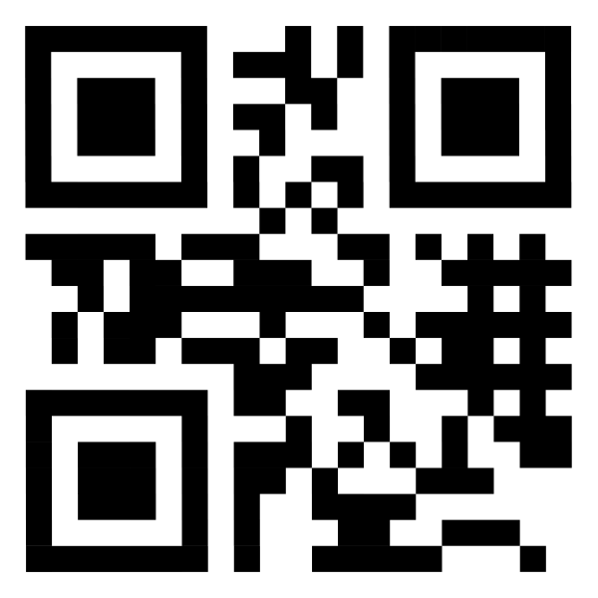

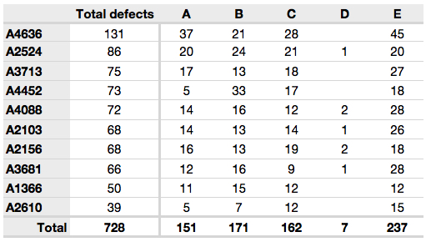






Flowchart
Scan QR Code
Recorded responses
Access Data
Get list of tools to be returned
12:00 PM
Script to generate token
Token generated
Obtain Credentials
Create list of User emails
Log error or success message
Send email with list of Tools to be returned

Slide 6
Code Overview
Define scope, sheet ID and range.
Define method to draft and send emails.
Define the main method.
Open the log file if it exists or create a new log file.
Get the credentials from token if exists already or generate a token.
Upon successful validation, use the sheets service to get data from the google forms response.
Generate a list of all users based on the logic - “whose approx. return date lies in the next 2 days from today or the approx. return date is 28 days from the date of issue”.
Get list of tools for each user.
Send mail using step 2.
Log successful execution or any errors encountered.

Slide 7
Common errors and Debugging
There are a number of network/token/data based errors that can occur in this automation. A few of them are as mentioned below -
Network - The system should have active connection to internet. Also, the gmail account being used should be active.
Token - The token has an expiry date of 7 days from the date being generated on. Hence, token needs to be regenerated every week.
Data - The data used involves a lot of date formats. Hence, avoid manual addition/removal of data. Incase of these errors, make sure column 1 and 10 in the excel sheet are in the format of “MM/DD/YYYY HH:MM:SS” and “MM/DD/YYYY” respectively.
Note - Update of “Actual Return date” should be done manually by staff to avoid spamming users even after return of tools.

Slide 8
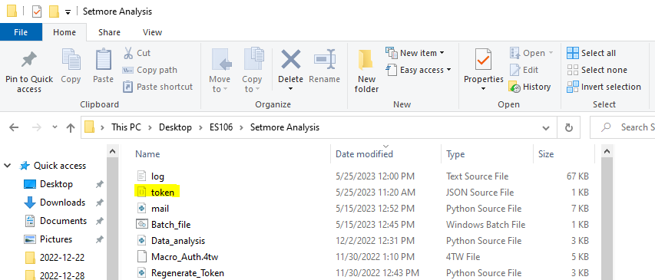
Weekly Maintenance
There are various maintenance tasks that need to be carried out throughout the week.
Token regeneration - This needs to be done every week on Tuesday before 12:00 PM. To do this, just run a windows script “Tool Issue” on desktop. A new token file should be created in the location shown below -

Slide 9
Weekly Maintenance
2. Respond to email queries - sometimes users reply with concerns and extension in return dates. These need to be manually updated in the excel if the request is genuine.
3. Regular Log file check - It is essential to check the automation ran successfully every day. This can be done by opening the log file generated under the same file location where the token exists and checking date wise execution message.

Slide 10
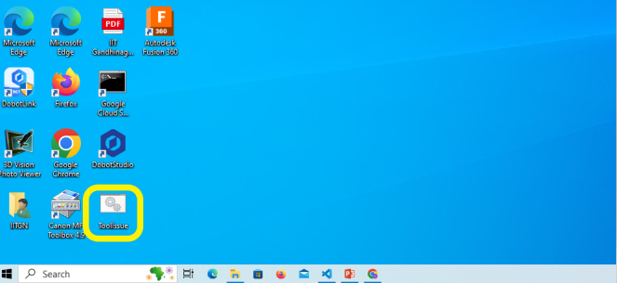
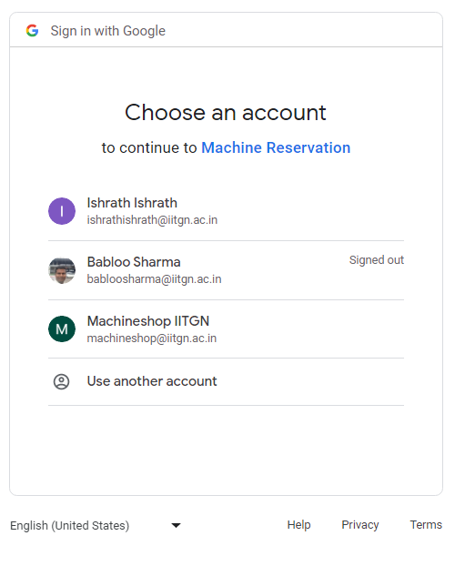
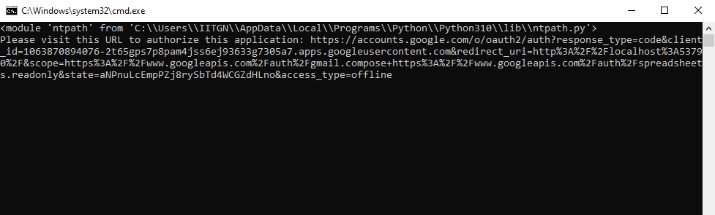
Appendix
Steps to run the “Tool Issue” windows script.
Click on the script as shown in fig.1.
Two new windows as shown below open up -
Fig.1. ToolIssue script on Desktop
Fig.2. Authentication flow

Slide 11
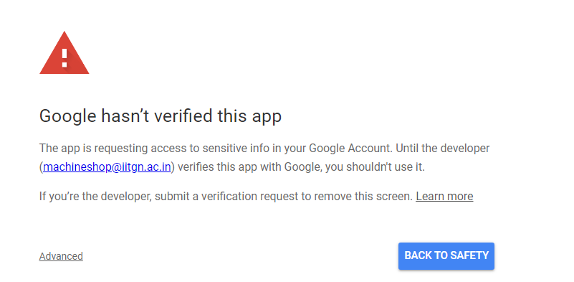
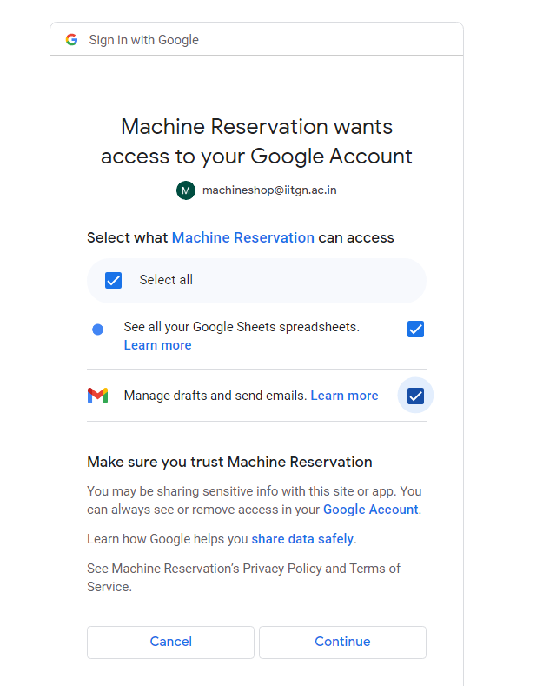
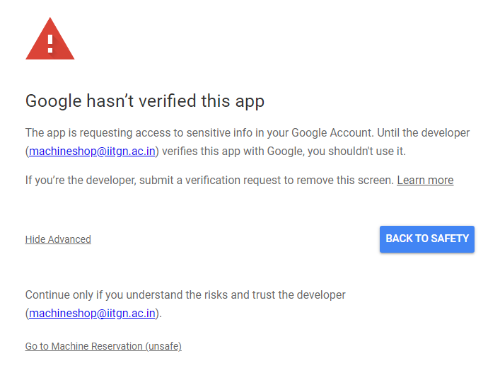
Appendix
3. Choose Machineshop IITGN account and type in the credentials.
4. Click on the advances button.
5. Click on “Go to Machine Reservation (Unsafe)”.
6. Check the box for
Select all and click
on continue.

Slide 12
Appendix
7. Close the tab on process completion message.
8. Close the command prompt and ensure “Token successfully regenerated” message is shown on the screen.
This ends the token regeneration process.

